Slide 1
Building a Highly Available, Scalable Web Application
NV21060 – Sayed Mohammed
NV21061 – Anas Khalid
NV21070 – Mohammed Hussain
NV21058 – Ebrahim Fuad
20/9/2023
Notes:
For Educators: You can use this template to help your students effectively present and communicate their project to a broader audience. Your students can also use this presentation as a portfolio of their work to demonstrate their cloud skills.
The presentation structure is listed below. The total time may vary depending on the activity you want to conduct. For example, you may want your students to provide high-level walkthrough of their final solutions versus deep-dive into why or how they chose certain services and the steps of building their architectures.
Suggested timing for a 15-minute presentation:
Introduction – 30 seconds
Business scenario overview – 1 minute
Solution overview – 5 minutes
Architecture diagram of the solution – 2 minutes
Demo – 5 minutes
Lessons learned – 1.5 minutes

Slide 2
Business scenario overview
University is preparing for the new school year. The admissions department has received complaints that their web application for student records is slow or not available during the peak admissions period because of the high number of inquiries.
Solution requirements: Functional, Load Balanced, Scalable, Highly Available, Secure, Cost Optimized, High Performing
Notes:
Define the problem or opportunity that you are addressing. Include pictures, figures, and statistics to help the audience better conceptualize the problem or opportunity.
Specify who your users or customers are and what pain points they are experiencing.
For example: “Users complain that the student admissions department website is too slow and isn’t always available.”
Also, list any specific business requirements that you are addressing.
For example: “Improve the experience for users. The web application can be deployed to the AWS Cloud. The application must be highly available, scalable, load balanced, secure, and performant architecture that can support thousands of users.“
Note:
An above-bar overview succinctly defines the problem and opportunity statement. For example: “Customers with media files, such as retail companies, need an easy and cost-effective way to analyze photos and videos of their inventory.”
A below-bar overview is too verbose, technical, or not specific. For example: “The most common media files are .jpg and .mp4. Companies have media files of their inventory.”

Slide 3
Solution overview
We built a web application for a university to store students records.
We configured the VPC and the subnets to be publicly accessible to host the EC2 to be accessible for the users.
Users can view, insert, edit, and delete the records in the web application.
Notes:
Explain at a high level what you have built.
For example: “I built a web application for a company to host their blog.“
Talk about why you chose certain parts of the solutions and any tradeoffs that you made. Focus on how you designed the solutions and how you applied the AWS Well-Architected Framework as part of the process (AWS Well-Architected Framework: https://docs.aws.amazon.com/wellarchitected/latest/framework/welcome.html).
For example: “I configured load balancers and auto scaling to make the application highly available and reliable.”
Include the use cases that you are addressing. Think about who your users are and how they would want to interact with your solution to solve their problem.
For example: “Users can view, upload, edit, and delete blog posts. Administrators can approve blog posts.”
Talk about the use cases that you addressed as part of the minimum viable product (MVP) that you scoped and built.
Note:
An above-bar description is concise and includes the most important benefits. For example: “The solution allows customers to quickly upload, store, and search large catalogs of images and videos in Amazon S3.”
A below-bar description is too detailed or not specific. For example: “Our solution analyzes media files.”

Slide 4
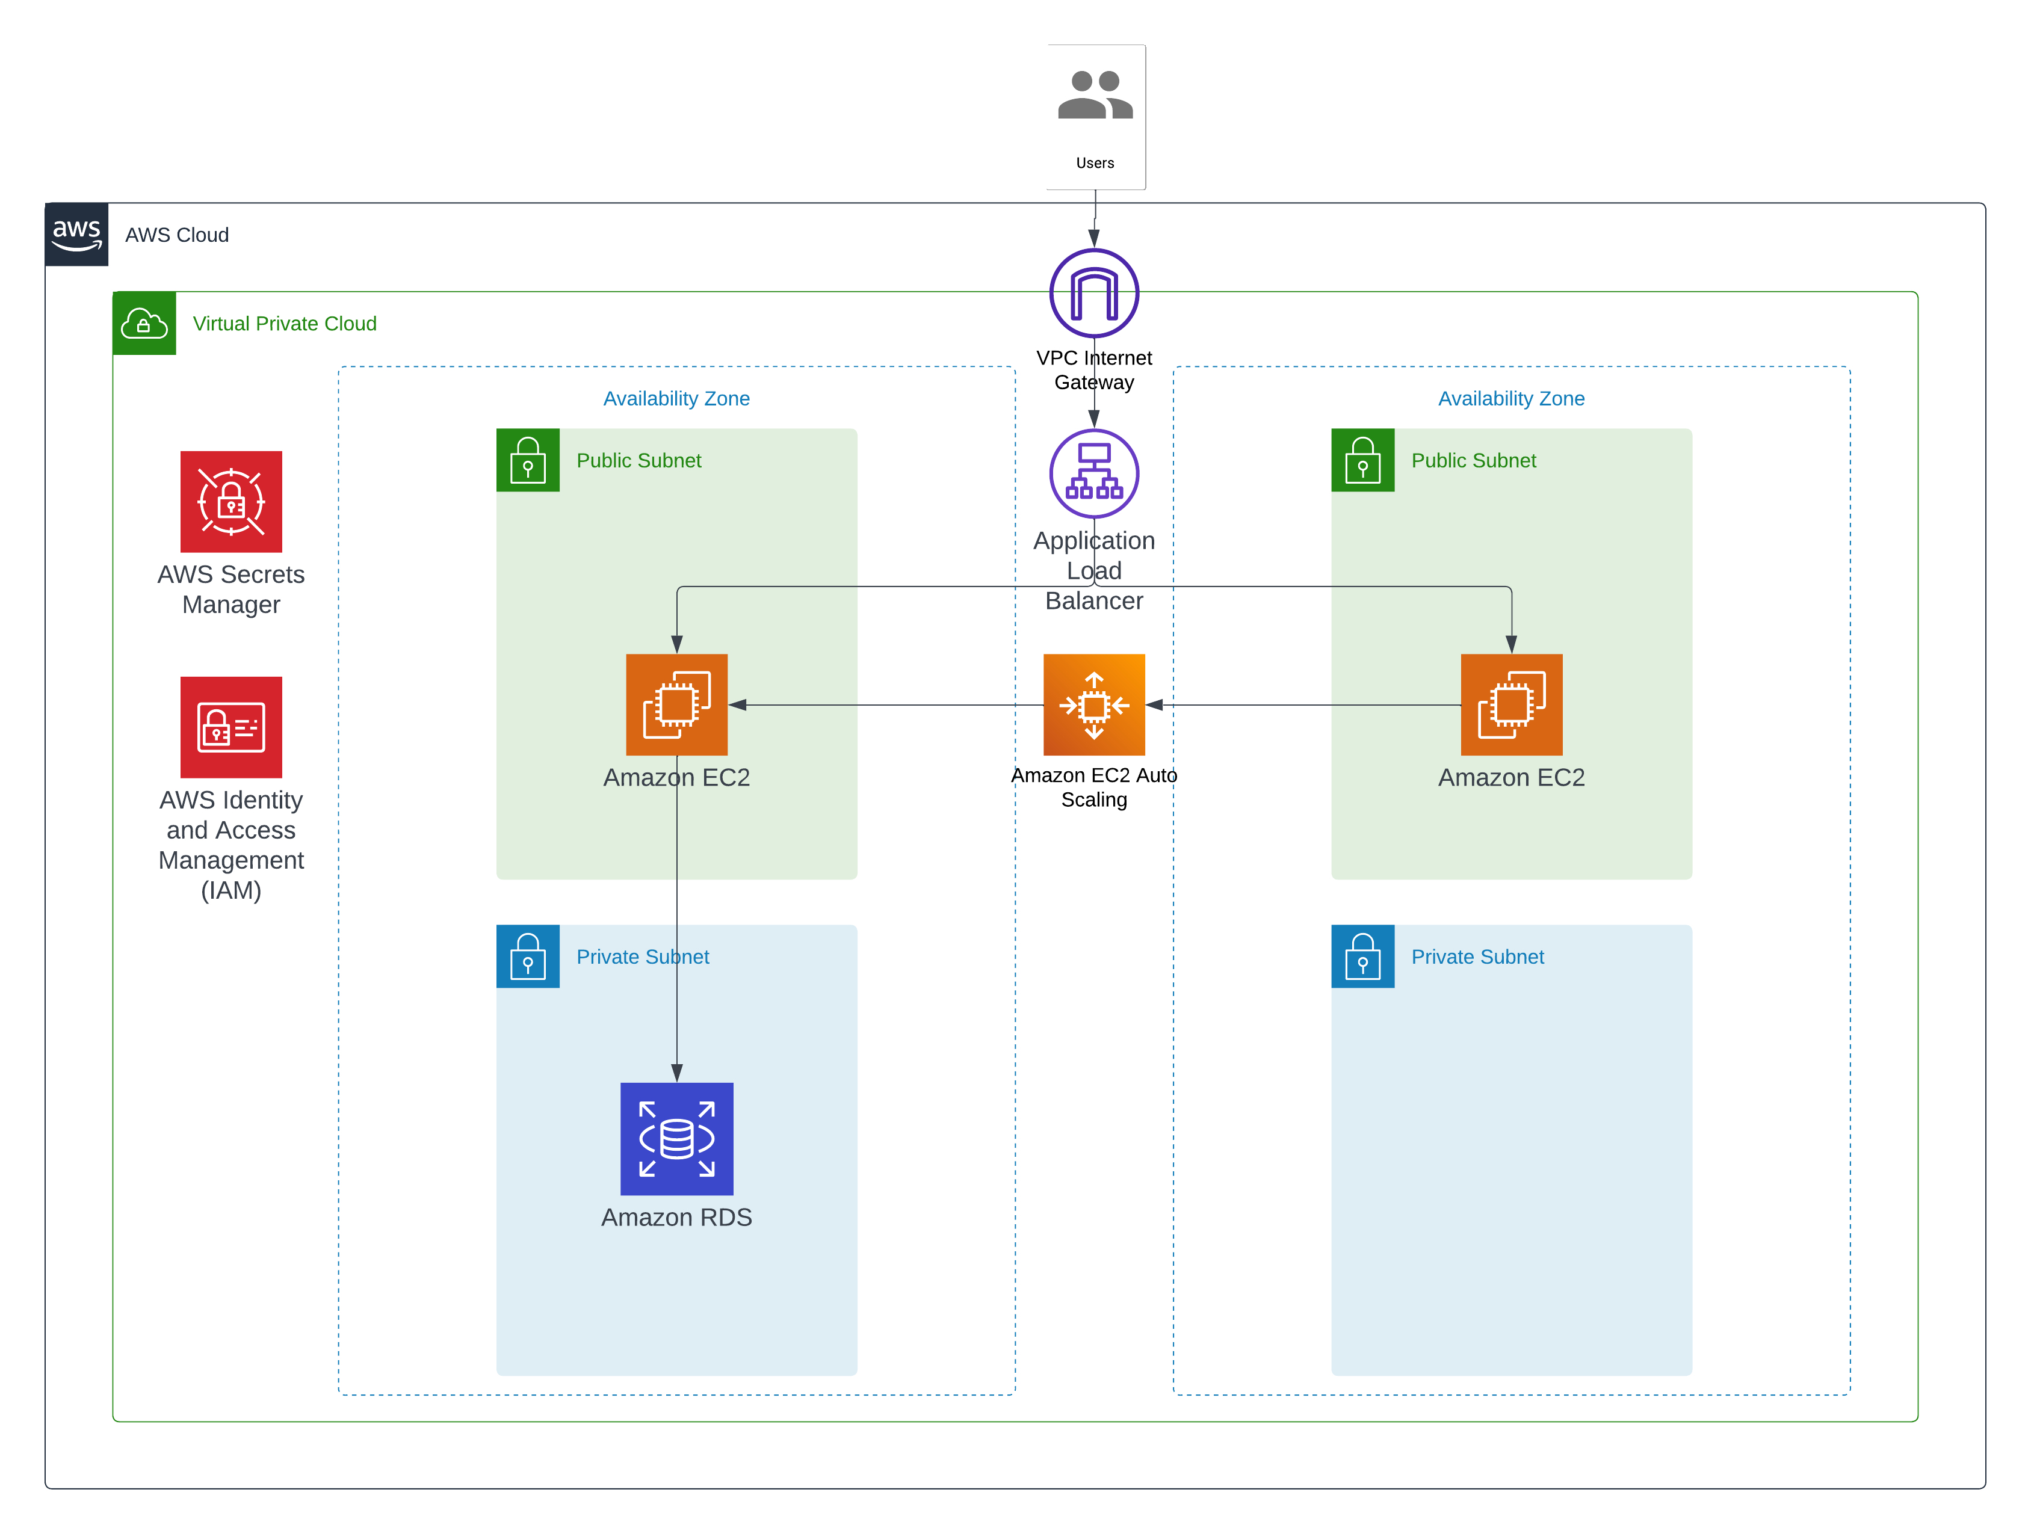
Architecture diagram of the solution
Notes:
Use the following resources to create a diagram of your application architecture:
AWS Architecture Icons at https://aws.amazon.com/architecture/icons. This page includes diagram assets as well as links to drawing and diagramming tools that you can use.
As you walk through the architecture, make sure that you relate back to the business requirements and the AWS Well-Architected Framework (https://docs.aws.amazon.com/wellarchitected/latest/framework/welcome.html).
You can also go more in depth about the design considerations and trade-offs that you made.

Slide 5
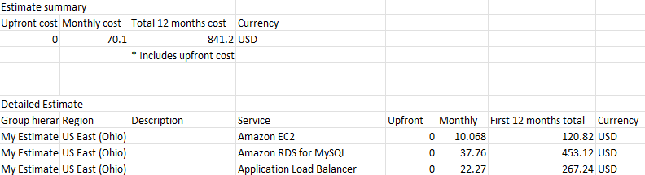
Cost Estimate

Slide 6

Phase 1
Was the planning the architecture design and estimating cost. In this phase we started by choosing the services that will be appropriate for the workload. Then we estimated the cost of the proposed solution and show it to our teacher.

Slide 7

Phase 2
We created a basic functional web application that was only to check if the code will run properly on the EC2. We created the VPC and subnets in this phase; in addition, we created the EC2 in a single AZ and started testing it.

Slide 8

Phase 3
We changed the VPC configuration and added subnets to deploy the web application in multi-AZ. We created and configured the RDS Database to connect it to the EC2. We created EC2 with the code dedicated to being connected with the RDS. We created Cloud9 to create the secret manager and migrate the data in the previous EC2.

Slide 9

Phase 4
We implemented high availability and scalability in the web application. We created application load balancer and used auto scaling to handle increasing loads. Finally, we tested the app and it was fully functional and it was highly available deployed on two different availability zones.

Slide 10
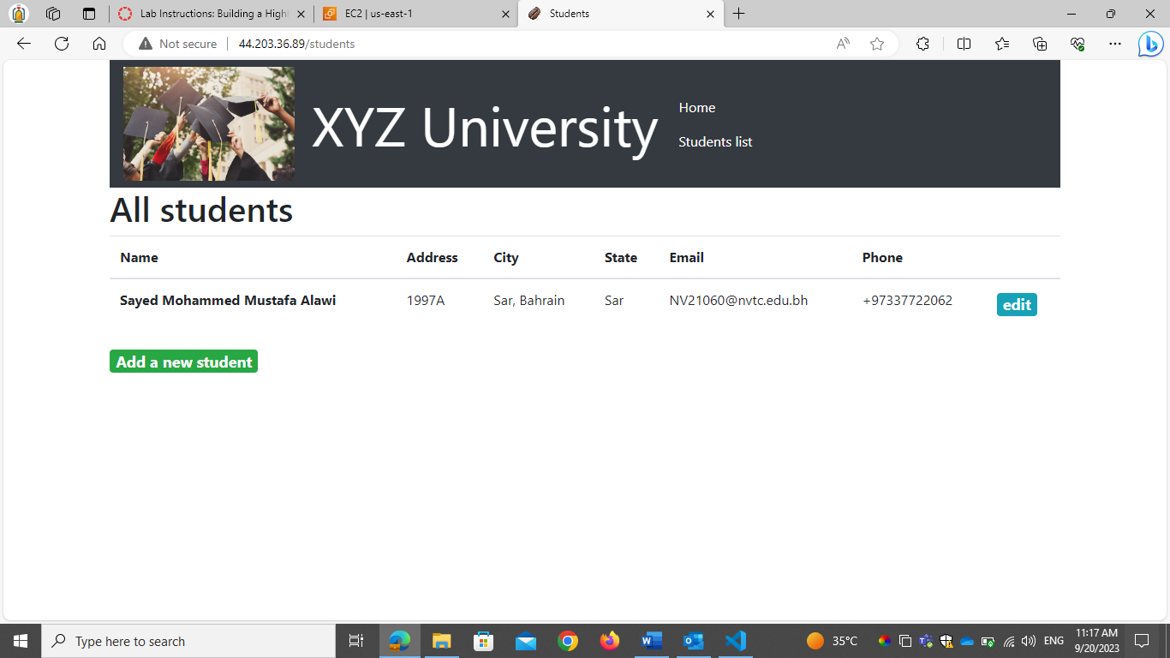
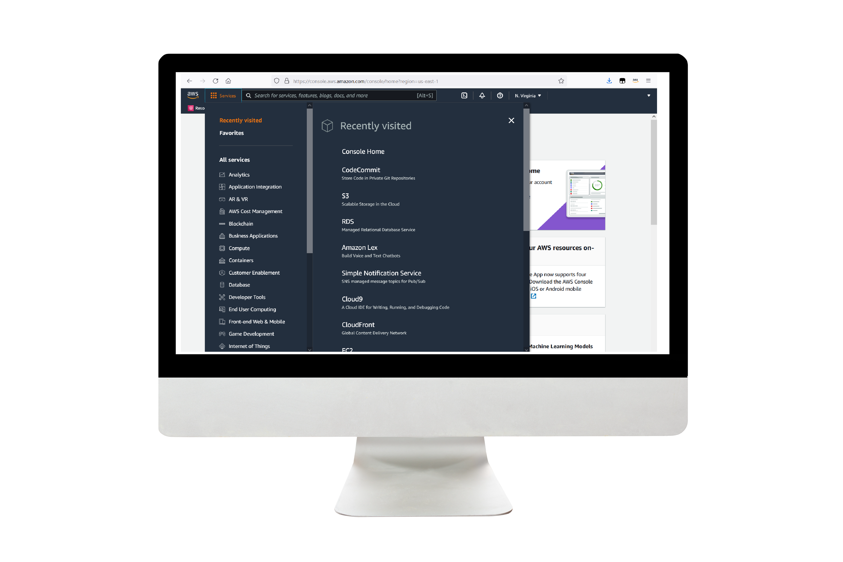
Demo
Notes:
For the demo, guide the audience through the two to three most important benefits of the solution and how it addresses the requirements.
Your demo materials can be screen captures, recordings, a link to your final solution, and/or a link to AWS console.

Slide 11
Conclusion
Building a highly available and scalable web application is crucial in today's digital landscape. To achieve this, developers should employ solid architecture, fault-tolerant systems, cloud technologies, horizontal scaling techniques, effective monitoring, and rigorous testing.
These strategies help distribute traffic and data across multiple servers, reduce the risk of single points of failure, and enhance availability.
Cloud platforms offer flexible computing resources, allowing applications to scale up or down based on traffic patterns.
Horizontal scaling techniques like containerization and microservices architecture facilitate scalability. Continuous monitoring and alerting systems help identify bottlenecks early, allowing proactive measures.
Finally, rigorous testing and performance optimization are essential throughout the development lifecycle to improve efficiency and meet user needs.

Slide 12
Thank you

